Slide 1
The release regime
for IOC New Development

Slide 2
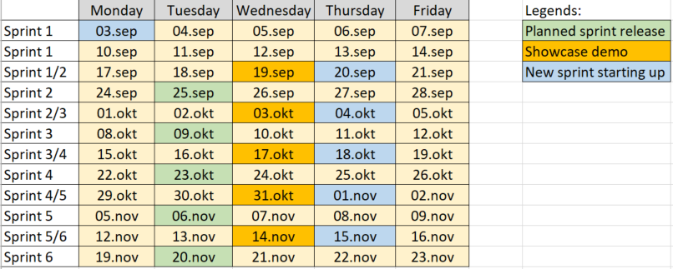
Release types and planned sprint releases
We have two types of releases in ServiceNow:
IOC Sprint Release – This is a planned release six days after the showcase demo
IOC Bugfix Release – Unplanned releases which are set up when there is a requirement
The next planned releases are :

Slide 3
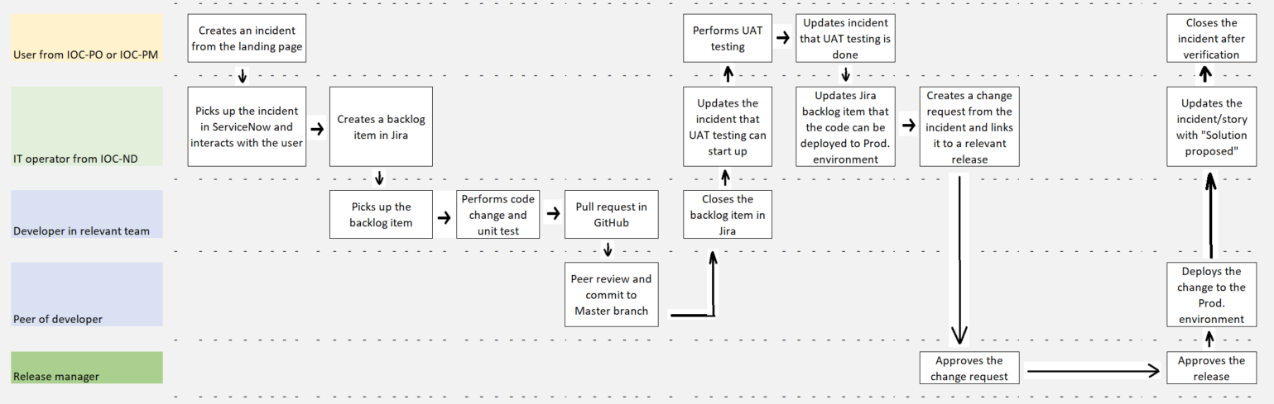
The change/release process for bugfix handling

Slide 4
Requirements for using the bugfix releases
Only users from IOC-PO or IOC-PM can create incidents relevant for the bugfix releases
Only bugs found in the IOC production environment are relevant (not dev or test)
Only bugs which cannot wait until next planned sprint release are relevant
Urgent incidents should be updated with a moderate priority – ref. KB0026439
The release manager should be contacted asap when there is a bugfix change
Only the IT operators should be using ServiceNow.

Slide 5
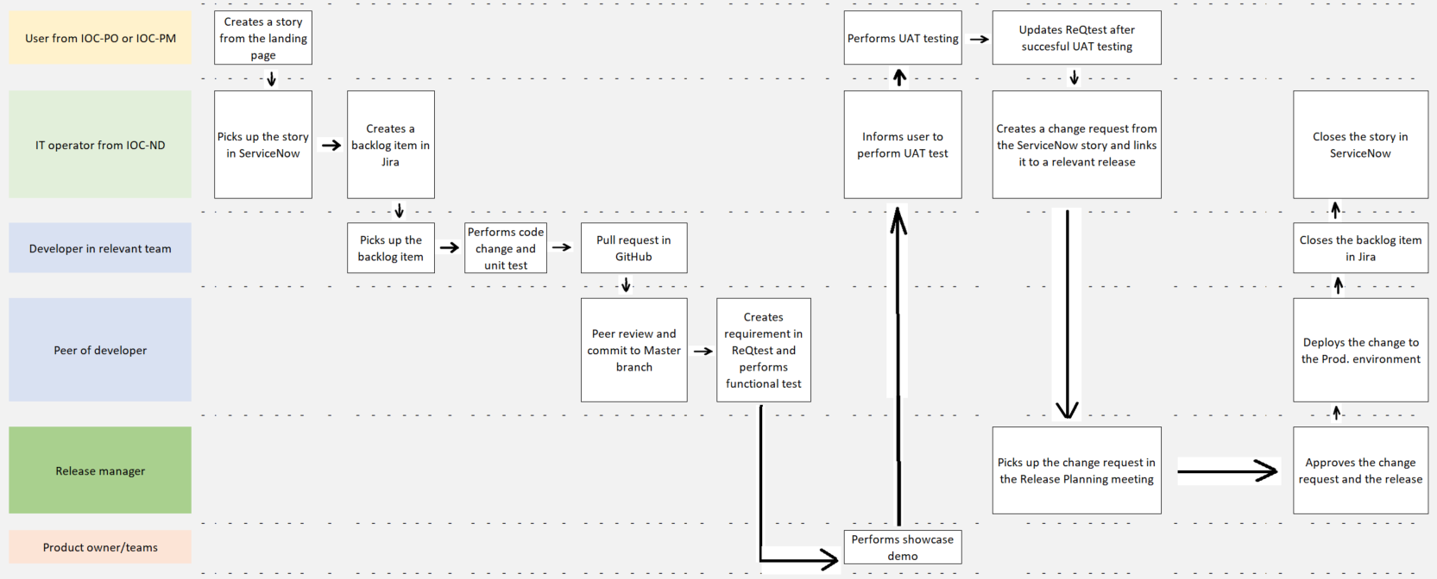
The change/release process for story handling

Slide 6
Comments regarding the user stories
If the user stories are created by the product owner or a sprint team member we don’t need to create user stories in ServiceNow.
We always need to create a change request in ServiceNow however, so if there doesn’t exist a story in ServiceNow the IT operator should just create a standalone change request

